Slide 1

Mortality Indicators

Slide 2
Quiz
A 54-year-old male with past history of type 2 diabetes mellitus developed acute STEMI on May 22, 2016. He was admitted to ICU. On May 24, he developed atrial fibrillation followed by embolism of right MCA. He was placed on ventilator and vasopressor support but expired on May 27, 2016 at 4 p.m. Prepare his death certificate.
Part – I
Disease condition leading to death
Due to / as consequence of
Due to / as consequence of
Part II
Other significant condition contributing to death but not related to disease causing it.

Slide 3
Answer
Cerebral embolism (rt MCA)
AF
Acute STEMI
NIDDM

Slide 4
MCQ - 2
Which of the following enumeration methods has separate units for enumeration in rural and urban areas?
(a) Census
(b) SRS
(c) MRS
(d) NFHS

Slide 5
MCQ - 3
Which of the following serves as a good method of obtaining data on morbidity due to a number of common and important diseases in our country?
(a) Death certificates
(b) IDSP
(c) SRS
(d) Census

Slide 6
MCQ - 4
Which of the following enumeration methods has legal backing through an “act” passed by the parliament
(a) Census
(b) SRS
(c) MRS
(d) Family Health Survey

Slide 7
MCQ - 5
Numerator not a part of denominator in :
Rate
Ratio
Proportion
All of the above

Slide 8
MCQ - 6
Discovery of penicillin by Sir Alexander Fleming was based on:
Epidemiological studies
Clinical studies
Laboratory studies
None of the above

Slide 9
MCQ - 7
In the statement “Tobacco smoking increases the risk of IHD by three times” the epidemiological aspect which is covered pertains to :
Person related distribution
Time related distribution
Place related distribution
Determinants

Slide 10
MCQ - 8
“The incidence of malaria is very high among migrant laborers in Odisha, Jharkhand and Chhattisgarh” the above statement includes which of the following components of epidemiology:
Person related distribution
Place related distribution
Frequency
All of the above

Slide 11
MCQ - 9
In the statement “55% of pregnant women in India are likely to have anemia” which of the following component of epidemiology is not included :
Person related distribution
Time related distribution
Place related distribution
Frequency

Slide 12
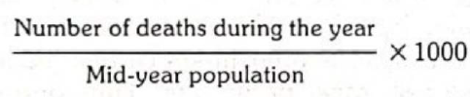
Mortality Indicator
Crude death rate
Simplest measure of mortality
“The number of deaths (from all causes) per 1000 estimated mid-year population in one year, in a given place”.
Summarizes – population composition & age specific death rates
They lack comparability for communities with populations that differ by age. sex, race, etc. However, they should always be examined first, and later the age-specific death rates which are the most useful single measures of mortality.

Slide 13
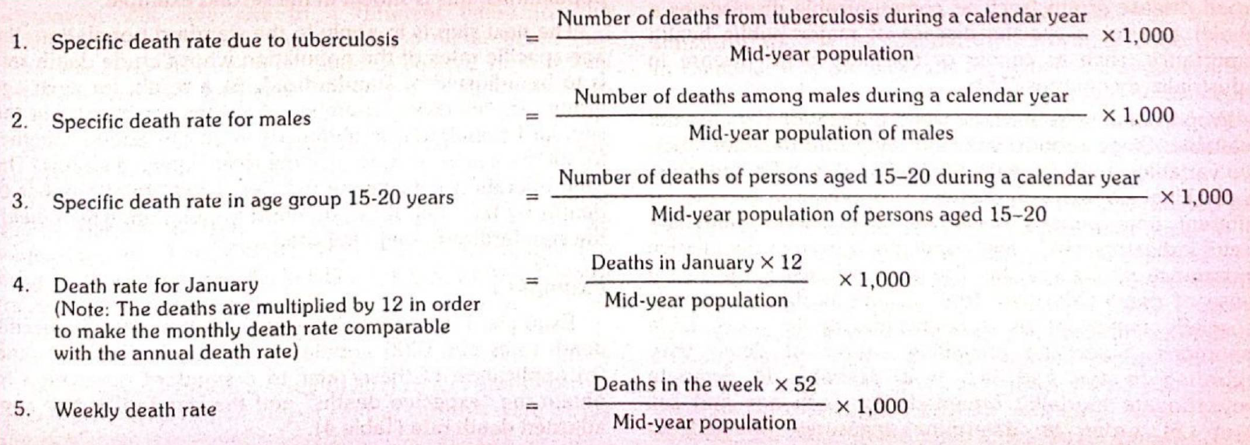
Specific Death rates
Help us to identify particular groups or groups “at-risk", for preventive action.
They permit comparisons between different causes within the same population.
Obtained mainly in countries in which a satisfactory civil registration system operates and in which a high proportion of deaths is certified medically

Slide 14
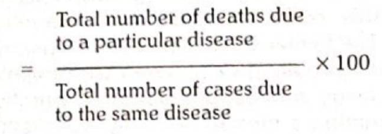
Case fatality rate (ratio)
Killing power of a disease
Typically used in acute infectious diseases (e.g., food poisoning, cholera, measles).
Its usefulness for chronic diseases is limited, because the period from onset to death is long and variable.
May vary in different epidemics because of changes in the agent, host and environmental factors. Its closely related to virulence.

Slide 15
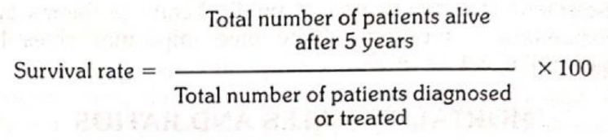
Survival rate
Describing prognosis in certain disease conditions.
Survival experience can be used as a yardstick for the assessment of standards of therapy.
The survival period is usually reckoned from the date of diagnosis or start of the treatment.
Survival rates have received special attention in cancer studies.

Slide 16
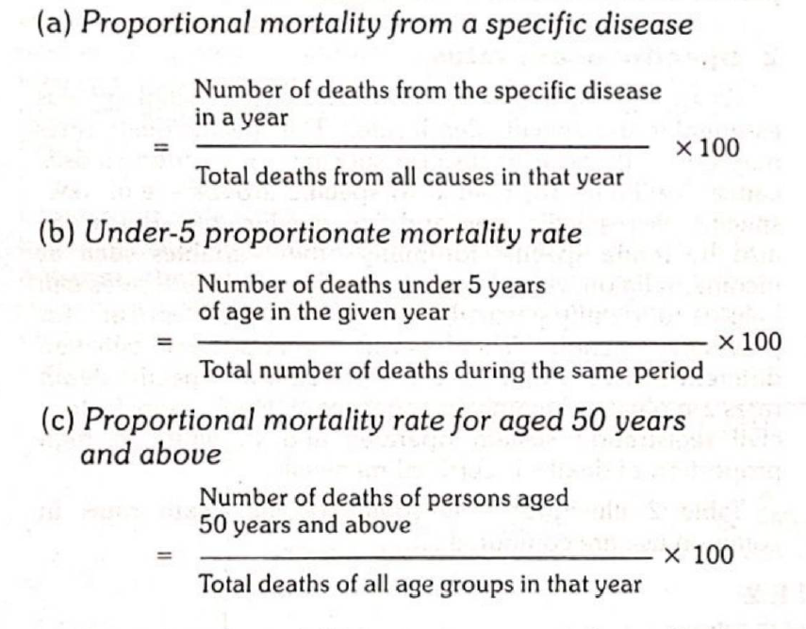
Proportional mortality rate (ratio)
Computed usually for a broad disease group (such as communicable diseases as a whole) and for a specific disease of major public health importance, such as cancer or coronary heart disease in industrialized countries
Proportional rates are used when population data are not available.
It is of limited value in making comparison between population groups or different time periods.
Proportional mortality rate does not indicate the risk of members of the population contracting or dying from the disease.

Slide 17
Limitations of mortality data
Incomplete reporting of death
Lack of accuracy – age& caue
Lack of uniformity
Choosing a single cause of death
Diseases with low ffatality

Slide 18
Mortality indices used in MCH
IMR – number of death among children of less than 1 year of age in a year for every 1000 live births in same year and same area
One of the most sensitive indicators of health and socio-economic condition
Maternal mortality ratio (MMR) – number of deaths due to maternal causes in year per 1000 live births in same area and same time
Maternal death – while pregnant / within 42 days of termination of pregnancy, irrespective of the duration, and site of the pregnancy, any cause related or aggravated by pregnancy; not by accidental / incidental causes
NMR – upto 28 days of age
Early neonatal MR – first 7 day
Perinatal mortality rate – fetal death (>28 weeks gestation) + infant (< 7 days); deno – total live + still birth (> 28 week gestation)

Slide 19
Standardization
Direct & Indirect Standardization
Set of techniques used to remove as far as possible the effect of differences in age or other variables when comparing
Age and sex are two of most common variable used for standardization

Slide 20
Direct
To compare health outcomes among population that may have different age distribution
When ASR are known for the population being compared
Standard population is used in order to eliminate effect of any difference

Slide 21
Steps
A hypothetical “standard population” is created
The ASR, whose crude rate has to be standardized is applied to standard population
For each group an expected number of death in standard population is obtained
Expected number of death are added together for all age group to get the total expected
Divide total expected by total standard population, which yield standardized rate

Slide 22
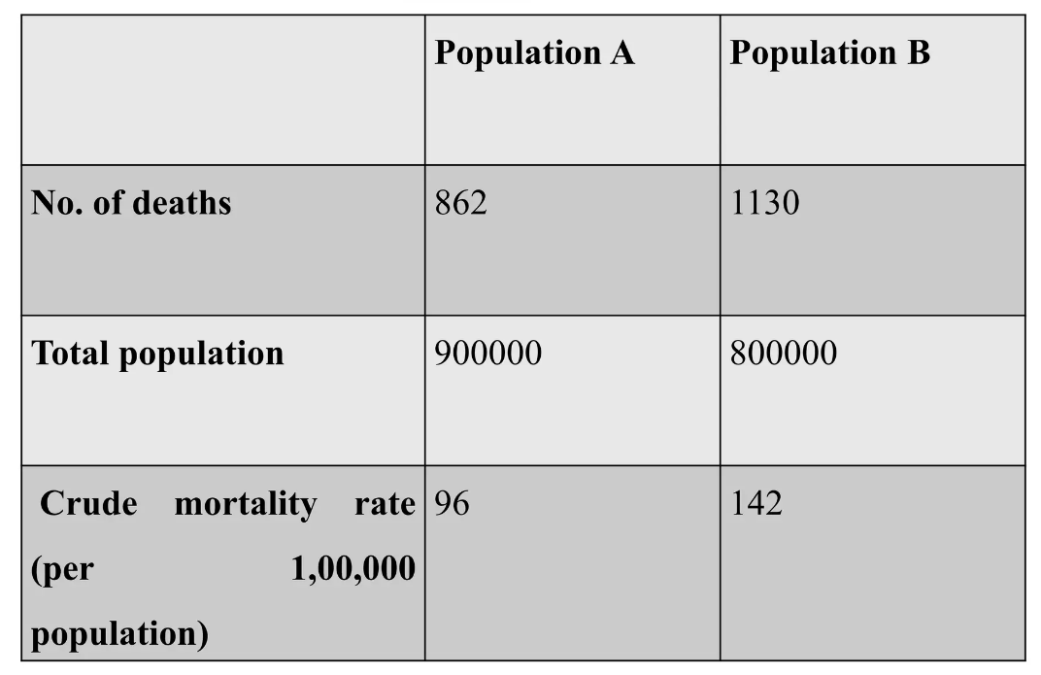

Slide 23
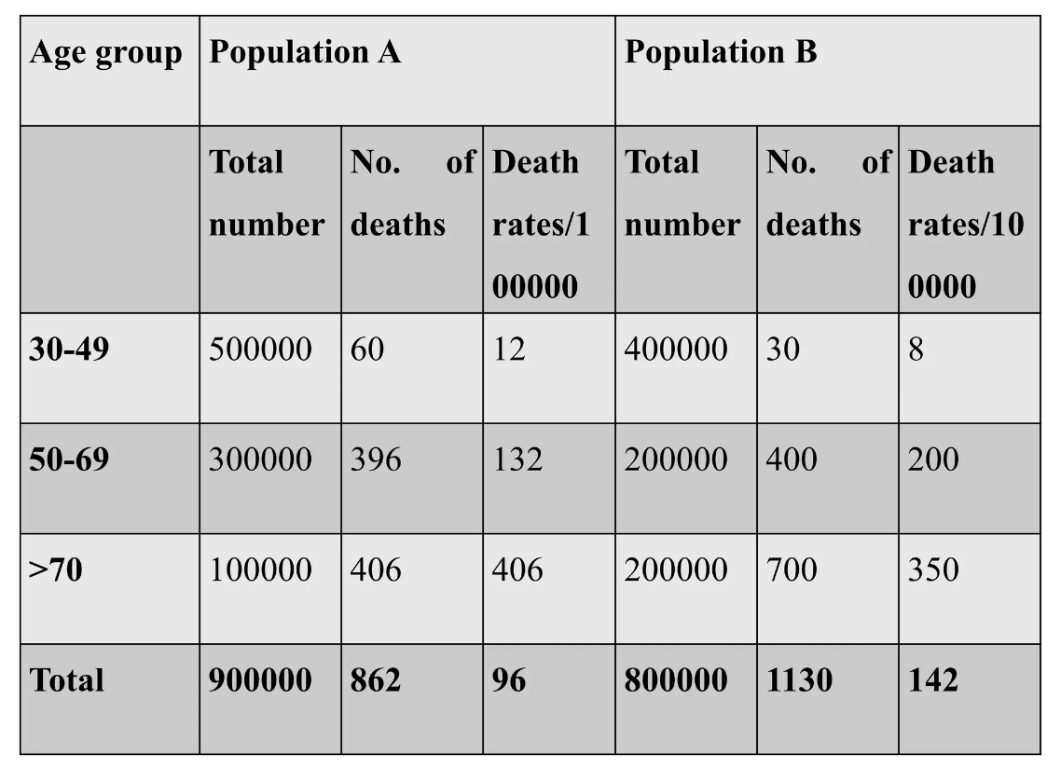

Slide 25
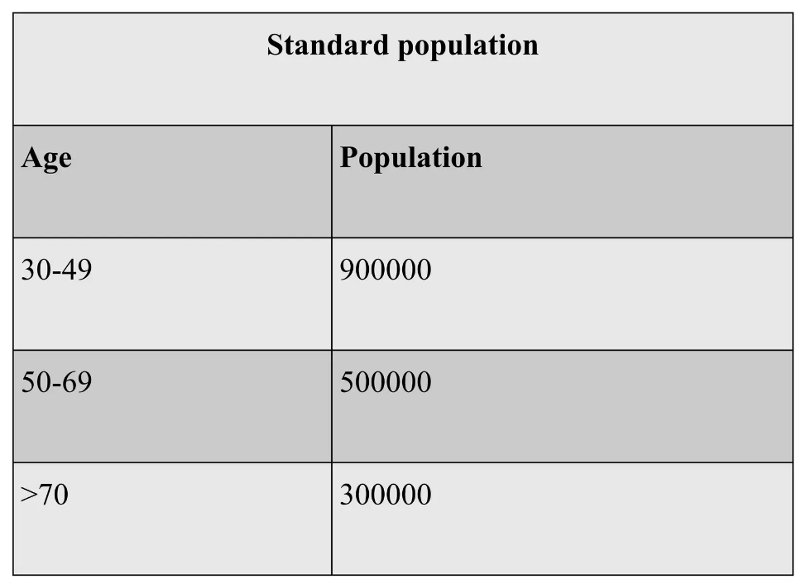

Slide 26
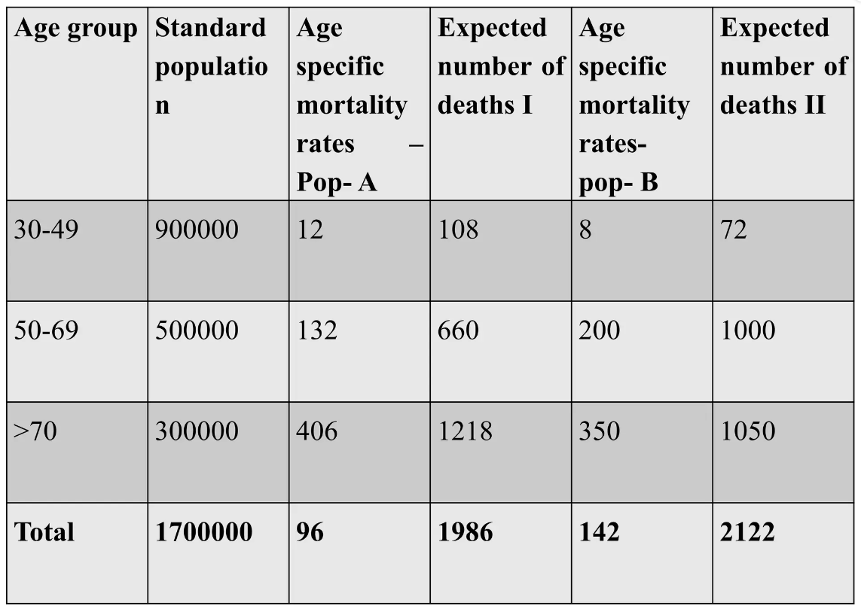

Slide 27
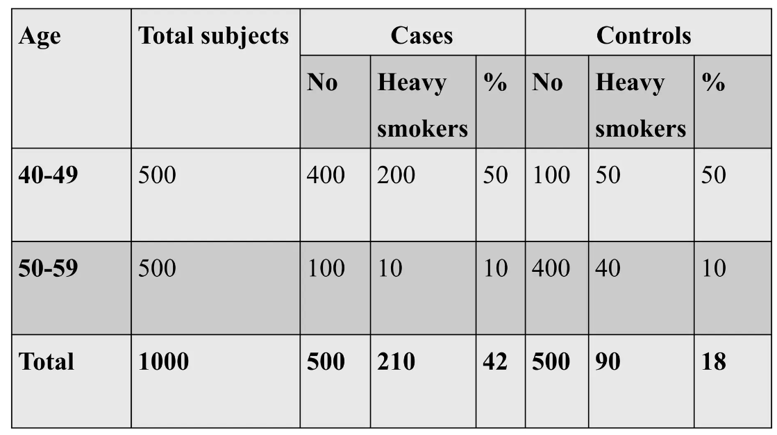

Slide 28
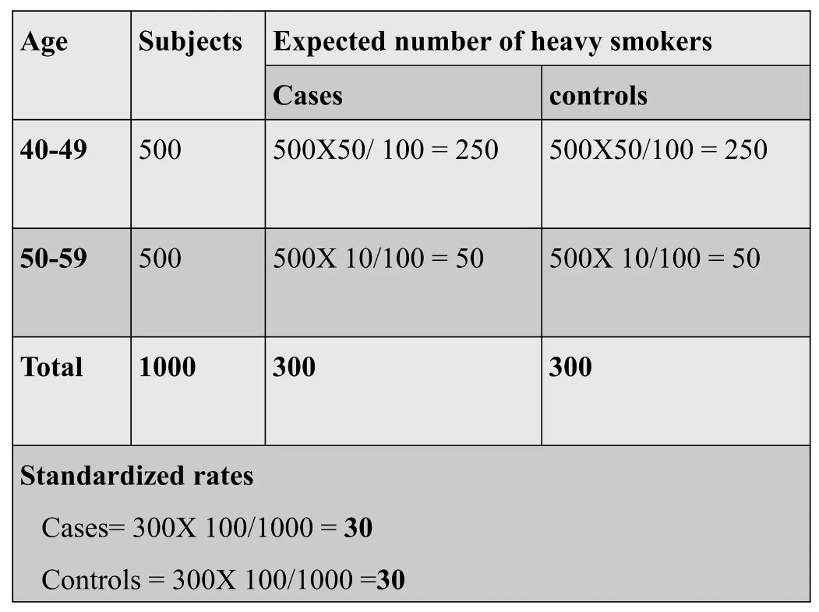

Slide 29
Indirect method of standardization
Requires the knowledge of the age and sex structure of the population as well as the age and sex specific rates of events under consideration for the standard population
Used when the number of deaths for each age specific stratum is not available

Slide 30
Steps
Step 1: Choose a reference or standard population.
Step 2: Calculate the observed number of deaths in the population (s) of interest
Step 3: Apply the age-specific mortality rates from the chosen reference population to the population(s) of interest.
Step 4: Multiply the number of people in each age group of the population(s) of interest by the age-specific mortality rate in the comparable age group of the reference population.
Step 5: Sum the total number of expected deaths for each population of interest.
Step 6: Divide the total number of observed deaths of the population(s) of interest by the expected deaths

Slide 31

Standardized mortality ratio
Ratio of the total number of deaths that occur in the study group to the number of deaths that would have been expected to occur if that study group had experienced the death rates of the standard population

Slide 32
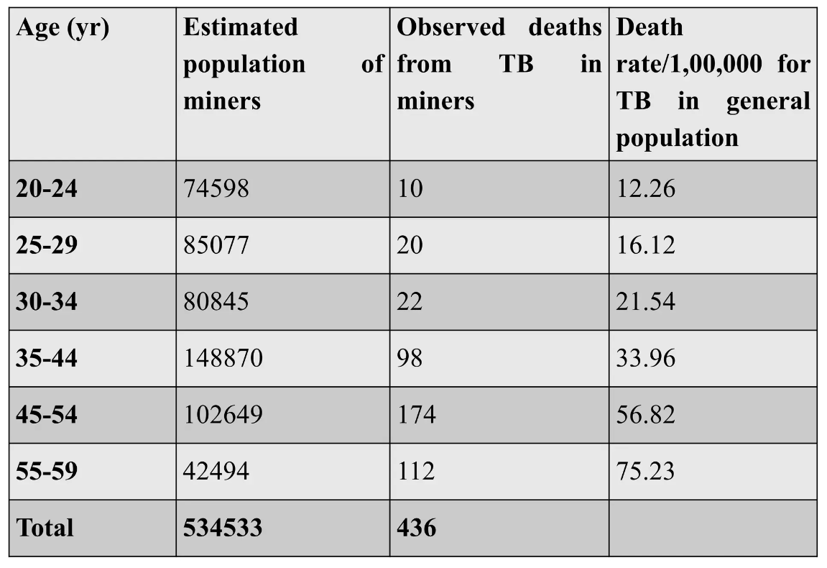
In a population of 5,34,533 miners in a country, 436 deaths from tuberculosis occurred in 2000.
The question of interest is whether this mortality experience from TB is greater than, less than or about the same as that expected from the general population

Slide 33
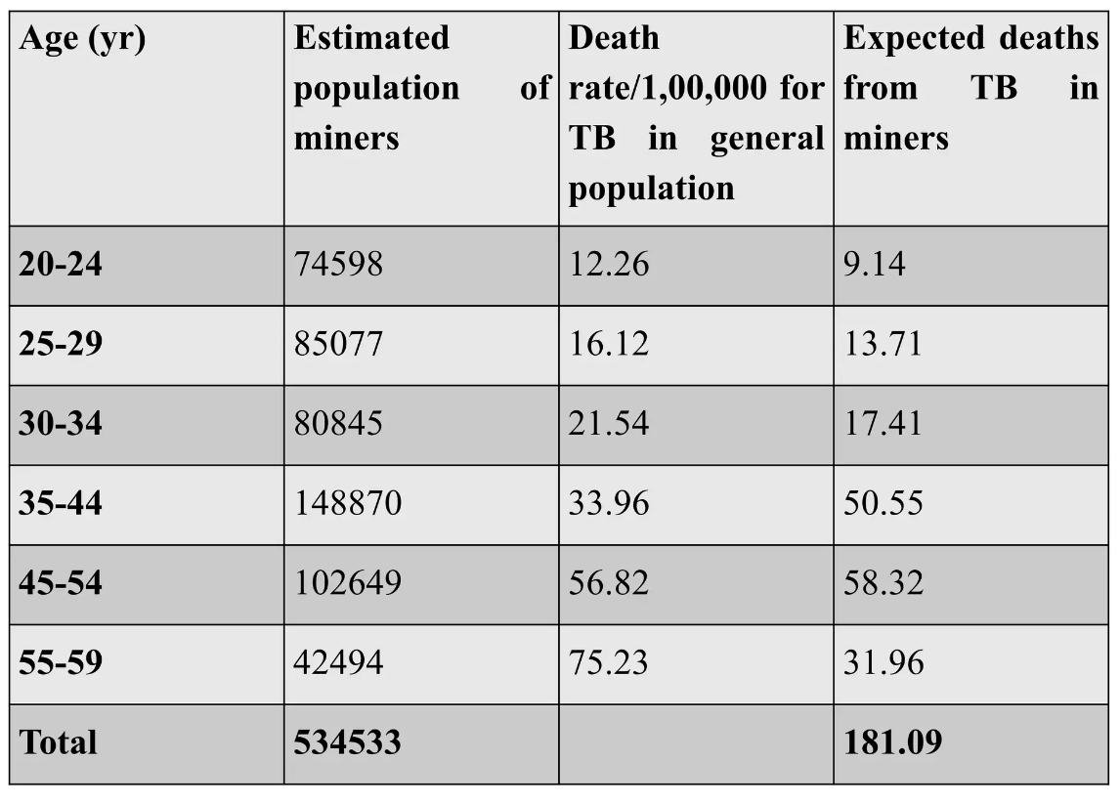

Slide 34
SMR -- ??

Slide 35
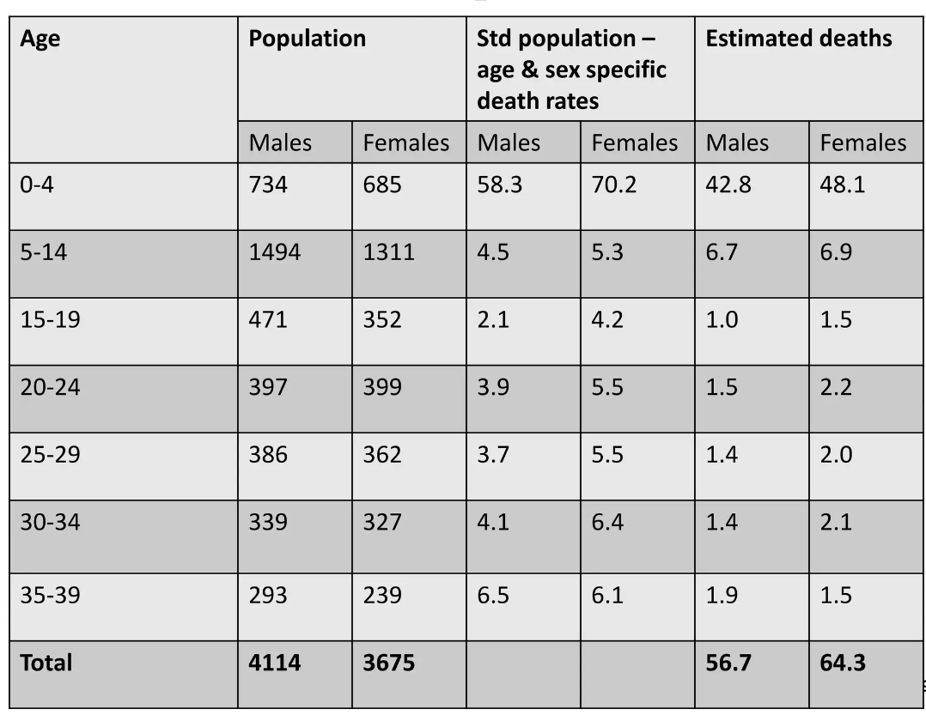

Slide 36
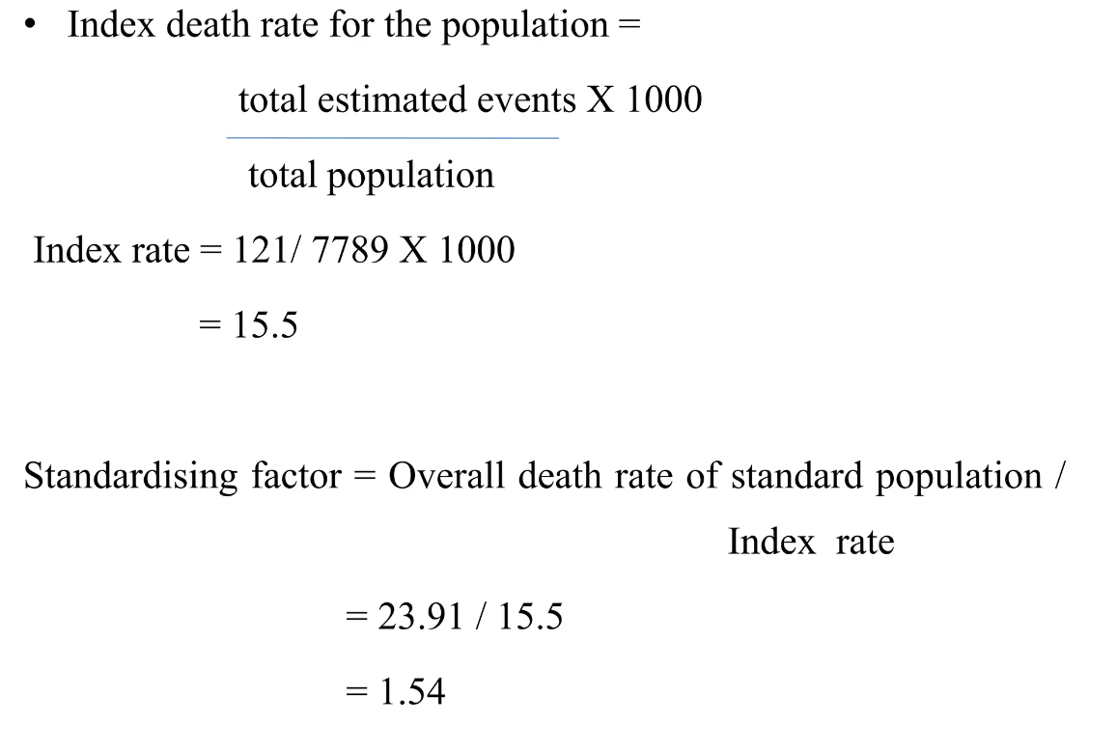

Slide 37
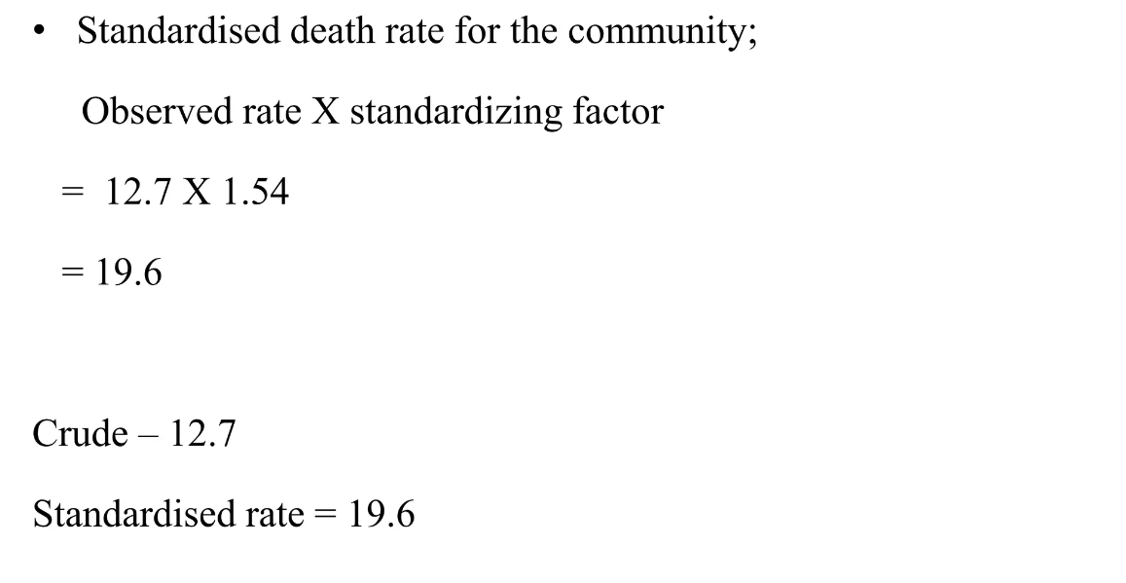

Slide 38
Advantages of standardization
Summarizes stratum specific rates
Unconfounded comparison of population

Slide 39
Limitations / Issues
Standardised rates are used for the comparison of two or more populations; they represent a weighted average of the age specific rates taken from a 'standard population' and are not actual rates.
The direct method of standardisation requires that the age-specific rates for all populations being studied are available and that a standard population is defined.
The indirect method of standardisation requires the total number of cases.
As the choice of a standard population will affect the comparison between populations, it should always be stated clearly which standard population has been applied.

Slide 40


Thank you

